Slide 1
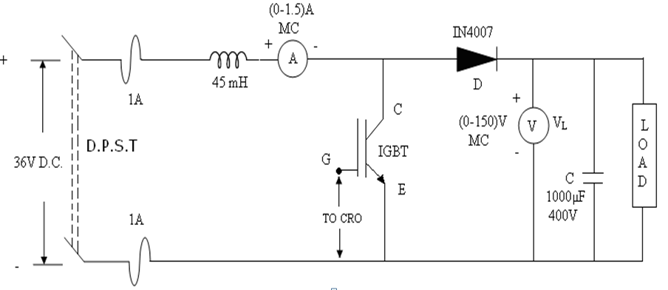
BOOST CONVERTER USING IGBT
Circuit Diagram:

Slide 2
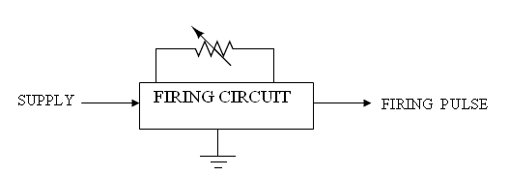
Model Graph:
Vo/Vin
Duty cycle

Slide 3


Formula used:
The average output voltage V_{o (avg)} =
Where Vo is the output voltage, Vin supply voltage in volts, δ is the duty cycle.
Where, Duty cycle, δ =
% Error =
x100 %

Slide 4
Observation:
Vin = ___________ V;
S.No | V_{o}(V) |  | T_{on}(mS) | T(mS) | δ = | Vo/Vin |  | I_{L}(A) | %Error
 | Measured | Cal |  |  |  | Measured | cal
1
2
3
4
5
6
7
8
9
10

Slide 5
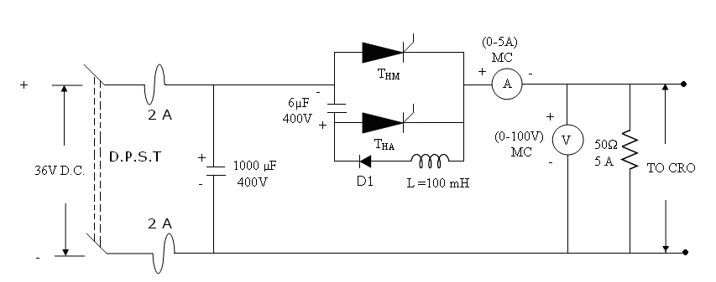
VOLTAGE COMMUTATED CHOPPER
Circuit Diagram:

Slide 6
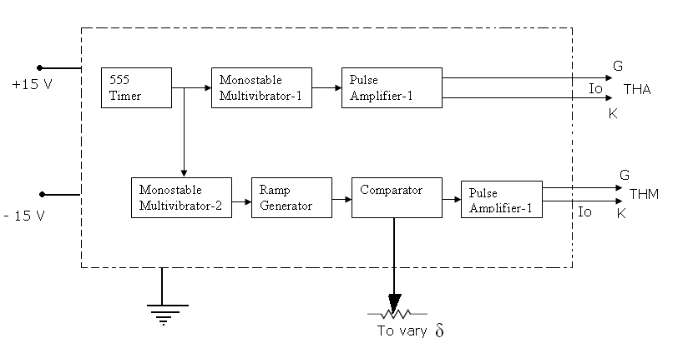
Firing circuit:

Slide 7
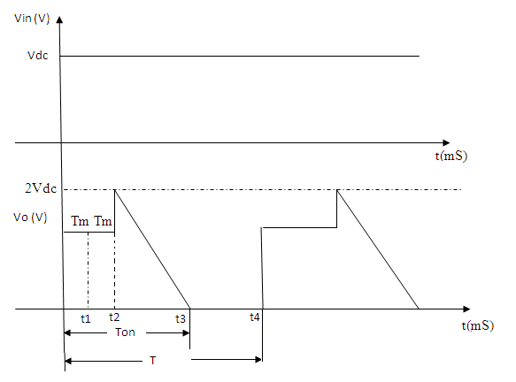
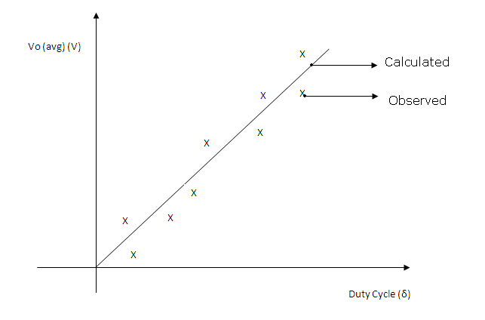
Model Graph:

Slide 8
Observation:
Vm = _______ V ; T = __________ ;
S.no | Ton (mS) | Vo =Vin .δ ( V) | Vo (Avg) (V) Measured | % Error
1
2
3
4
5
6
7
8
9
10

Slide 9
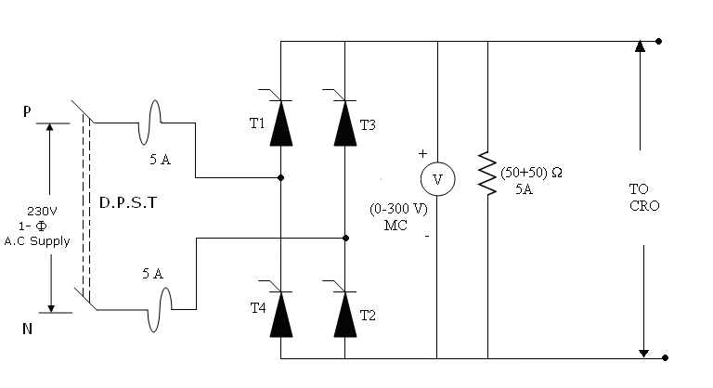
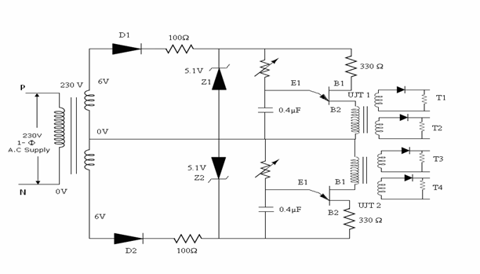
SINGLE PHASE FULLY CONTROLLED SCR CONVERTER
Circuit Diagram:
Firing Circuit:

Slide 10
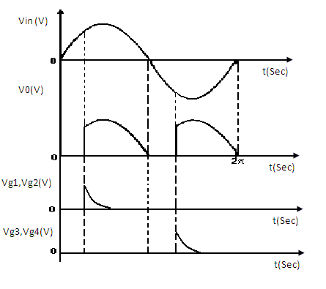
Model Graph:
Vo(V)
Vo (Cal)
Vo (Measured)
`
Firing angle(α)

Slide 11
Observations:
f = _________ ; T= 1/f = __________ ;
S.No | Firing Angle (α) | Vo (Measured) (V) | Vo (Cal) (V)
1
2
3
4
5
6
7
8
9
10

Slide 12
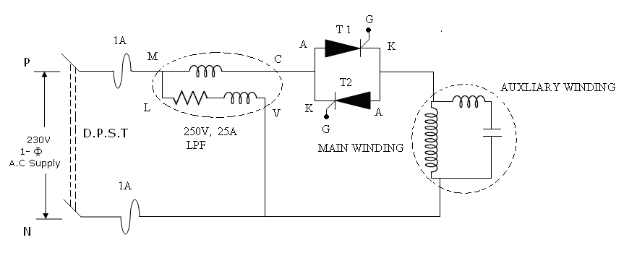
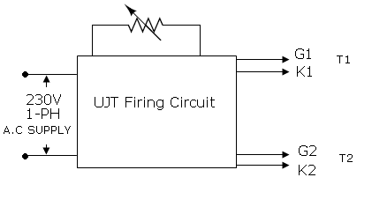
SPEED CONTROL OF SINGLE PHASE CAPACITOR RUN FAN MOTOR
Circuit diagram:
Using Back –Back SCR’S
Firing Circuit:

Slide 13
Model Graph:
Input
Power (W)
Fan speed (rpm)
η %
Fan speed (rpm)

Slide 14
Procedure:
Anti – parallel SCR method:
The circuit connections are to be traced as shown in the circuit diagram.
The firing angle of the anti- parallel SCRs are varied using a potentiometer and hence the speed of the fan motor.
The input power is measured from the wattmeter.
The output power is calculated using the approximation that T = kN².
The characteristic curves are drawn showing the variation of fan speed versus input power, % efficiency and the torque.

Slide 15
Tabulation:
Anti-Parallel SCR’S:
S.No | Power i/p(W) | Speed(rpm) | O/P Power(W) | η (%)
1
2
3
4
5
6
7
8

Slide 16
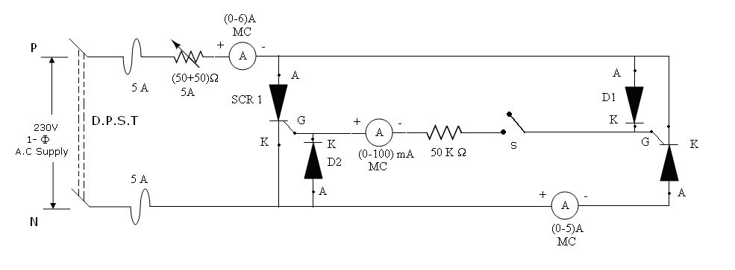
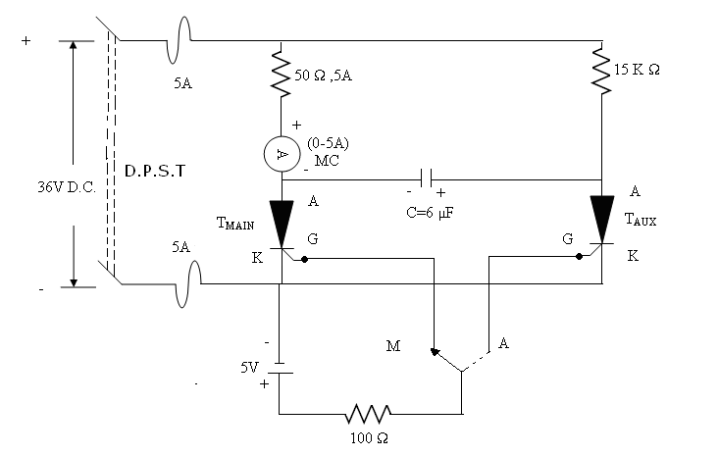
AC AND DC CIRCUIT BREAKER
Circuit Diagram:
A.C Circuit breaker
D.C circuit breaker:

Slide 17
Observations:
A.C Circuit Breaker: ( with switch closed )
D.C Circuit Breaker:
S.No | I_{L1} (A) | I_{L2} (A) | I_{g} ( A) | I_{L1} / I_{L2}
1
2
3
4
5
6
7
8
9
10
 | Switch at M | Switch at A
Load Current

Slide 18
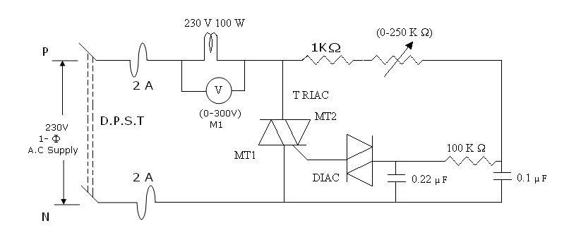
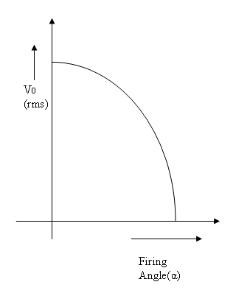
ILLUMINATION CONTROL OF LAMP
Circuit Diagram:
Model Graph:

Slide 19
Observations:
V_{in} = _______ v R_{L}= ________ Ω
S.No | Vo(rms) ( v) | Firing angle α (Degree) | P= Vo²/R_{L} (Watts)
1
2
3
4
5
6
7
8
9
10

Slide 20
BUCK CONVERETER USING IGBT
Circuit Diagram:
L=20mH
C
IGBT
E
G
To DSO
+
+
V
+
200µF
V _{in}
_{D}
(0-60V)MC
_
230Ω
36V DC
_
_
50V
V₀
Model graph:
(V)
Duty cycle, δ

Slide 21

Formula used:
Duty cycle, δ =
Duty cycle, δ =
% Error =
x100 %

Slide 22
Observation:
S.No | Duty cycle (%) | OUT PUT VOLAGE ( ) | OUT PUT VOLAGE ( ) | % Error | (Calculated) | (Measured)
1
2
3
4
5
6
7
8
9
10

